Slide 1

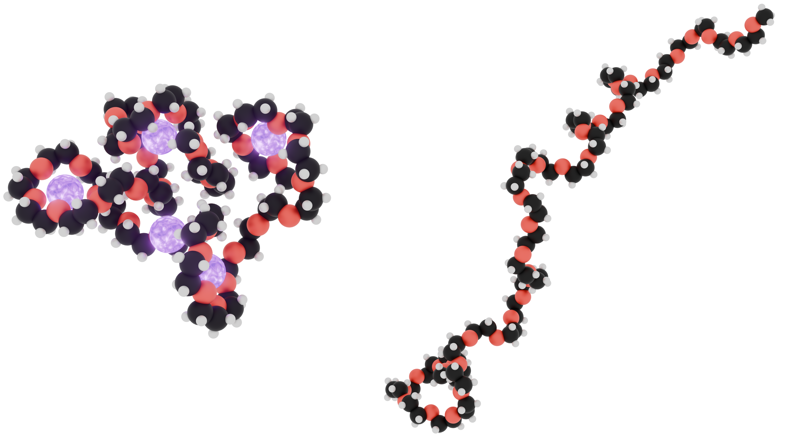




How Molecular Conformational Changes Affect Changes in Free Energy
Insight from Structural Analysis, Free-Energy Calculations, Kirkwood-Buff Theory
Structure and Solvation
The Solvation of PEG is Strongly Conformational Ensemble Dependent
Soft matter systems such as polymers and proteins undergo structural changes when exposed to thermal, mechanical, or chemical stress. While proteins typically adopt compact, folded structures under native conditions, stress can cause them to unfold, emphasizing the need to understand stress-induced shifts in excess chemical potential.
How does the Solvation of a Solute Change by Binding Solvent Species?
This study investigates how the solvation of polyethylene glycol (PEG) in water is affected by the addition of salt. Although NaCl typically induces a salting-out effect,^{1,2} the structural resemblance between PEG and crown ethers suggests that sodium ions might also interact with the polymer, potentially stabilizing its solvation environment. This intriguing system offers a unique opportunity to explore the interplay between salt-induced exclusion and ion binding.
The figure shows unidirectional and bidirectional ($Δμ^{\text{ex}}$) estimates of PEG’s solvation free energy when transitioning from its water ensemble into NaCl ($Δμ_{\text{upper}}^{\text{ex}}$) and from its NaCl ensemble back into water ($Δμ_{\text{lower}}^{\text{ex}}$).
Change of Structure Does Not Soften the Exclusion of NaCl From PEG
Free-Energy Calculation Method For Large and Flexible Solutes
Using energy-representation theory, we compute free energy changes with a unidirectional estimator that averages solvation free energy differences for solute configurations from the unperturbed ensemble,³ and a bidirectional estimator, akin to BAR, that accounts for the relaxation free energy of transforming between structural ensembles.⁴
Since the preferential binding coefficient is changing linearly with the NaCl concentration, the preferential binding contribution to the m-value is constant.
NaCl, 4 M
NaCl, 2 M
Water
Conclusion
We have developed a framework that calculates the change in the excess chemical potential of a solute due to co-solvent addition while providing significant mechanistic insights. Specifically, the upper and lower bounds reveal distinct driving forces acting on the structural ensembles characteristic of each solvent, whereas the bidirectional estimator yields the net free energy change. Finally, our results can be further analyzed through solvent-species and energy-domain decompositions to achieve a comprehensive thermodynamic understanding of the system.
References
Hervø-Hansen, S. (2022) Phys. Chem. Chem. Phys., 24.
Hervø-Hansen, S. (2024) Chem. Sci., 15.
Masutani, K. (2019) J. Chem. Phys., 14.
Hervø-Hansen, S. (2025) J. Chem. Theory Comput., 21.
Dr. Stefan Hervø-Hansen

